Slide 1
Followup
Presentation
For TOUCH New York

Slide 2
Visual Mockups for Digital Recordkeeping System

Slide 3
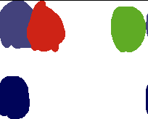
Visual Mockups: Typeface and Color Palettes
The UI design will match the design of the TOUCH website by using the same colors and fonts.
The three colors at the top are all picked from the TOUCH logo. The blue and red at the top should never be used to distinguish between two important items because their brightness is the same. The bottom two colors are picked from the TOUCH website.
Roboto is the font currently being used everywhere on the TOUCH website. It is a clean and simple font designed by Google that is in use on hundreds of popular services and apps.
Roboto

Slide 4
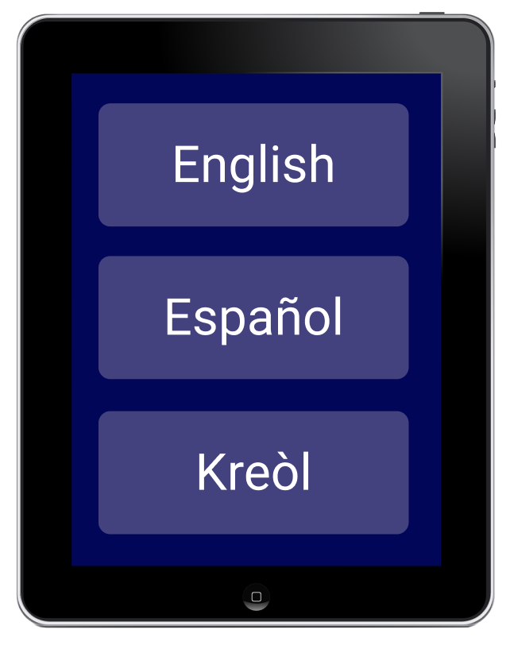
Visual Mockups: Form Language Select
The Client form can start with a screen that allows the user to pick their language.

Slide 5
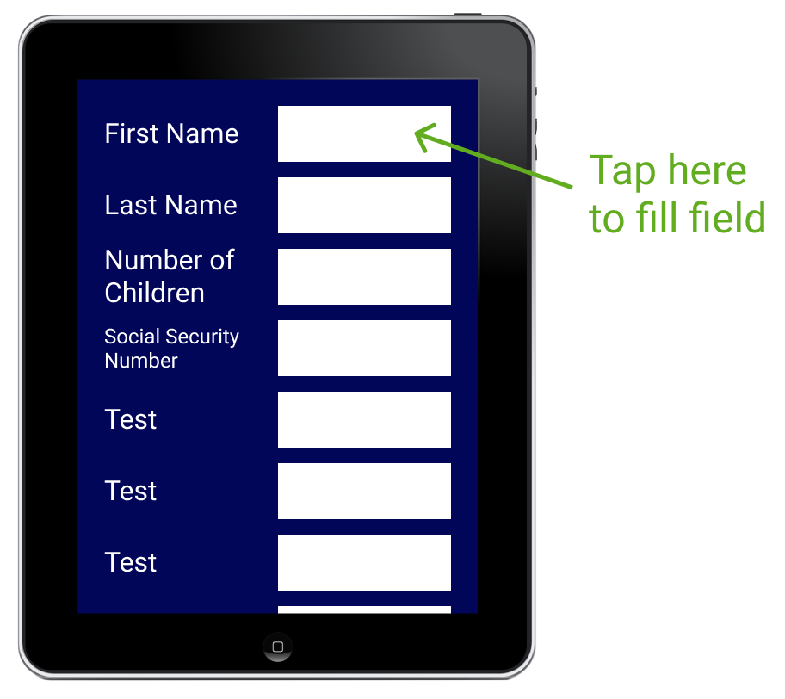
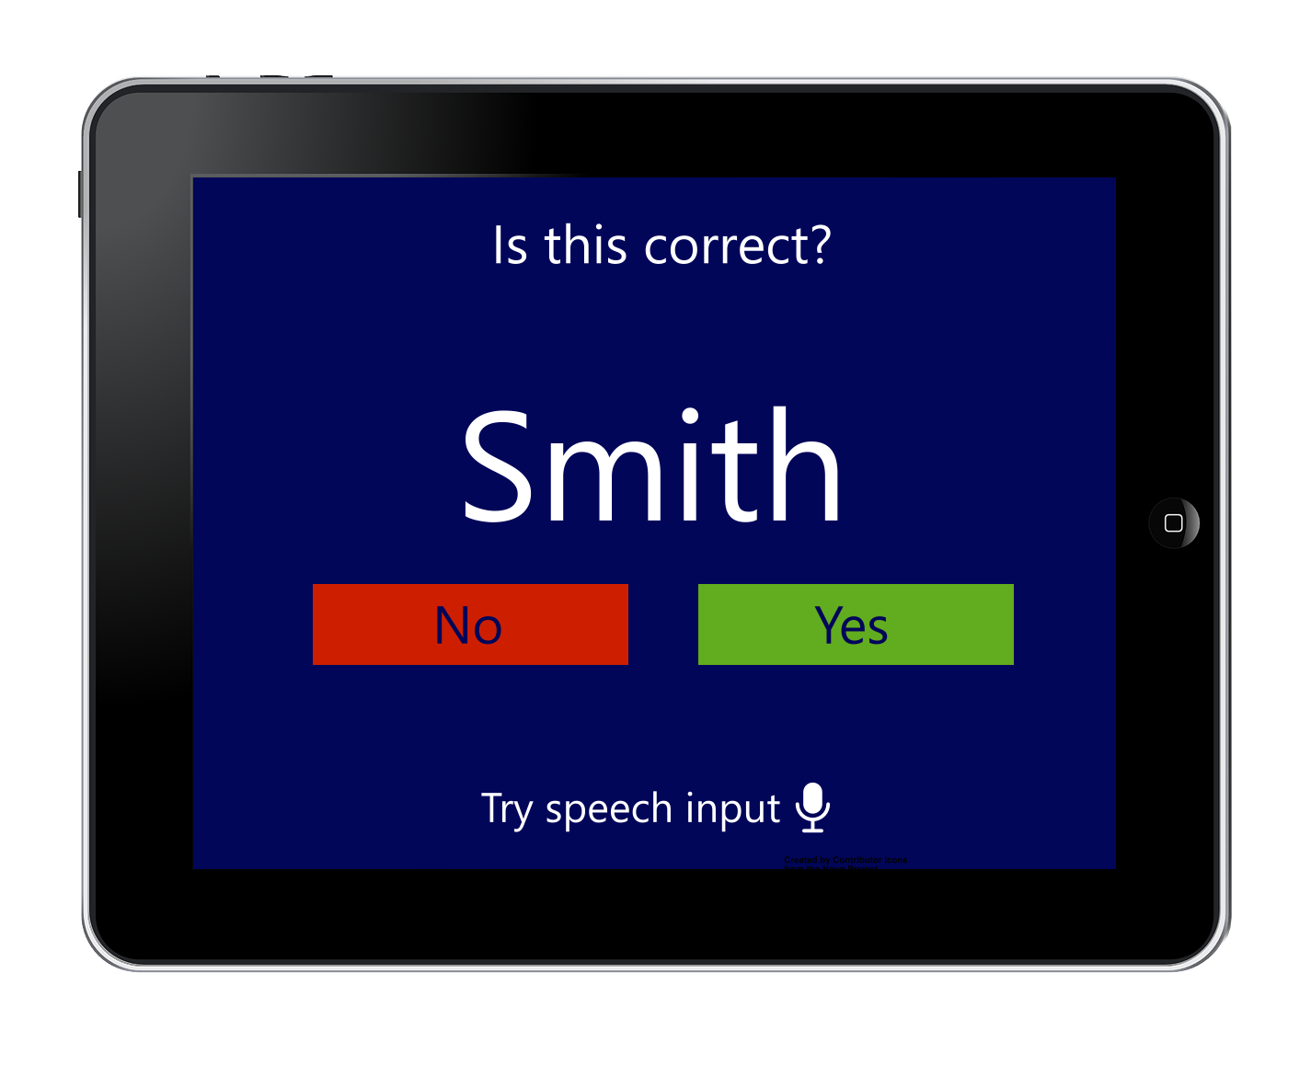
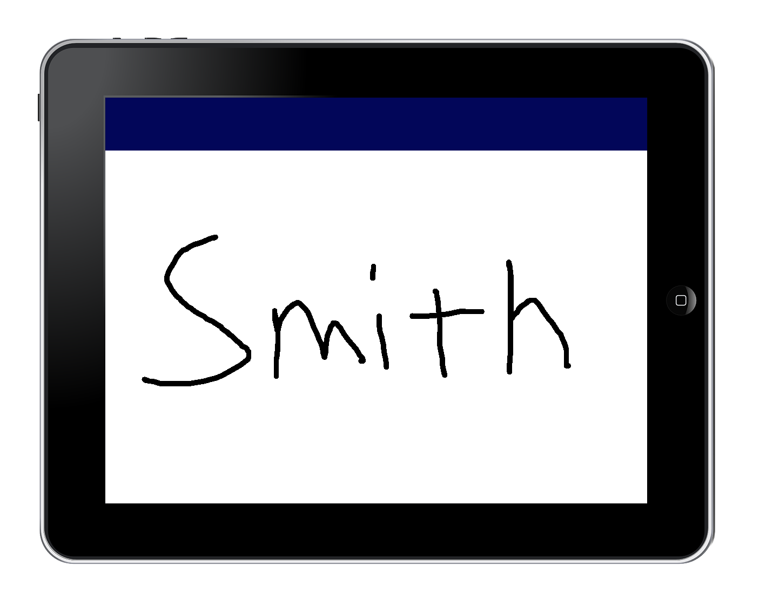
Visual Mockups: Form Interface
Please print your first name

Slide 6
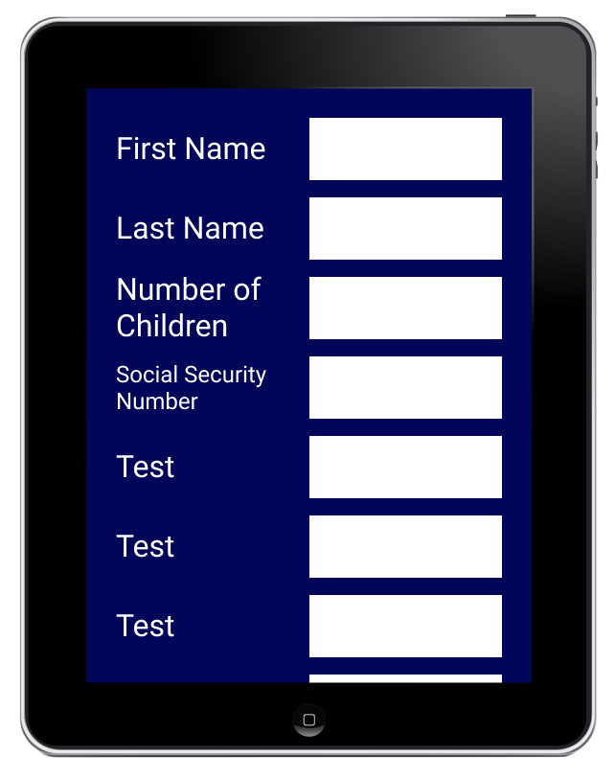
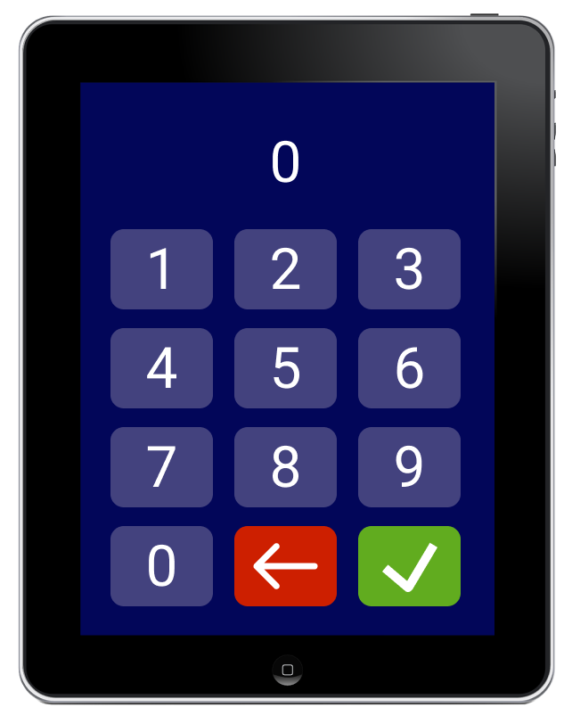
Visual Mockups: Form Number Entry

Slide 7
I Interviewed Tiffany Lloyd from TOUCH
On March 15th, I had a phone call with Tiffany Lloyd from TOUCH.
It seems that TOUCH already has many digital forms of data entry and record-keeping in place. Lloyd stated that when she joined TOUCH, she replaced an old paper form with a Google Forms version, which may be this Google Forms page for volunteer applications on TOUCH’s website
She stated that any remaining paper forms might not be a good fit for converting to digital. Some forms, like TEFAP forms, may be required by the government to be paper. Many of the volunteers are young disabled adults who might struggle to fill out a digital form (the handwriting and speech-to-text ideas may alleviate this).
I believe she mentioned Palmer’s “volunteer portal” idea and stated that it may not be a good fit for the volunteers for the same reason (though she stated that the host of a volunteer group may be able to make use of the portal).

Slide 8
I Interviewed Tiffany Lloyd from TOUCH [2]
In conclusion, what I learned from my call with Lloyd is it seems that TOUCH already has relatively robust digital data entry and record keeping systems in place.
However, Lloyd told me that other smaller agencies in the Rockland Community Against Hunger network (which TOUCH is the leader of) may need a digital data entry and record-keeping overhaul more than TOUCH. For example, I could help by receiving the paper forms that these agencies use, and creating Google Forms/Microsoft Forms pages.

Slide 9
Are TEFAP Forms Required to be Physical?
This question is a bit difficult to research, but it seems the answer is no, TEFAP forms can be digital.
the website for the Food and Nutrition Service of the U.S. Department of Agriculture states that "The use of electronic record keeping... ...in TEFAP is permitted, provided that the same degree of confidence regarding the accuracy of eligibility determinations results from the electronic system as from the traditional, paper-based system."
I believe it is the latter part of the quote that organizations struggle with. The website then links to federal regulations that must be complied to; however, these regulations do not give clear guidance on how to build an information system that meets the regulations.
IT and Information Security are far outside the field of food distribution orgs., which may lead to an avoidance of digital forms out of fear of breaking the law and going over budget.

Slide 10
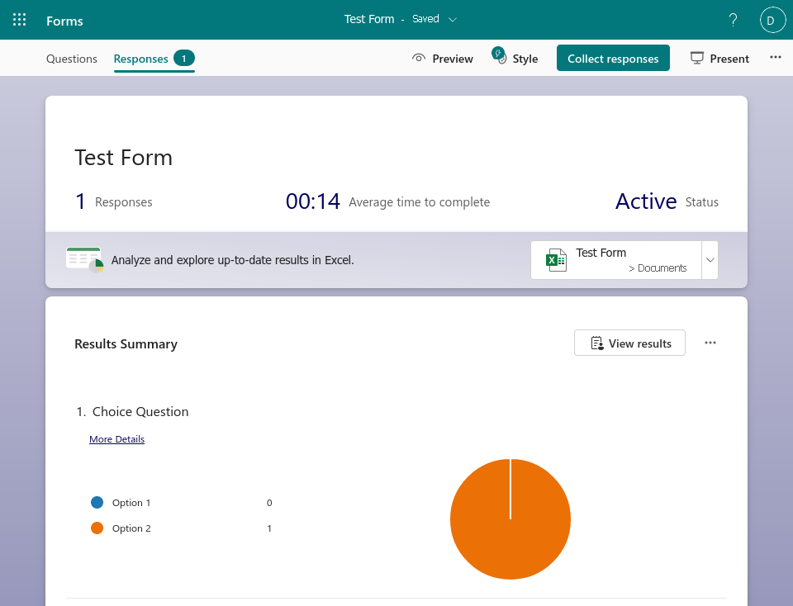
Alternative Idea: Microsoft Forms
The previous visual mockups were designed with the idea that they would be a new app.
However, using MS Forms could be a good option. The main advantage of MS Forms is that responses to surveys automatically sync up with a MS Excel (web) spreadsheet for data visualization. That Excel spreadsheet could then be imported into a MS Access database for permanent storage of records.
The main disadvantage is that using all of these MS apps requires Windows and a subscription to Microsoft 365. Although, both of these are so ubiquitous that many organizations may already have them.

Slide 11
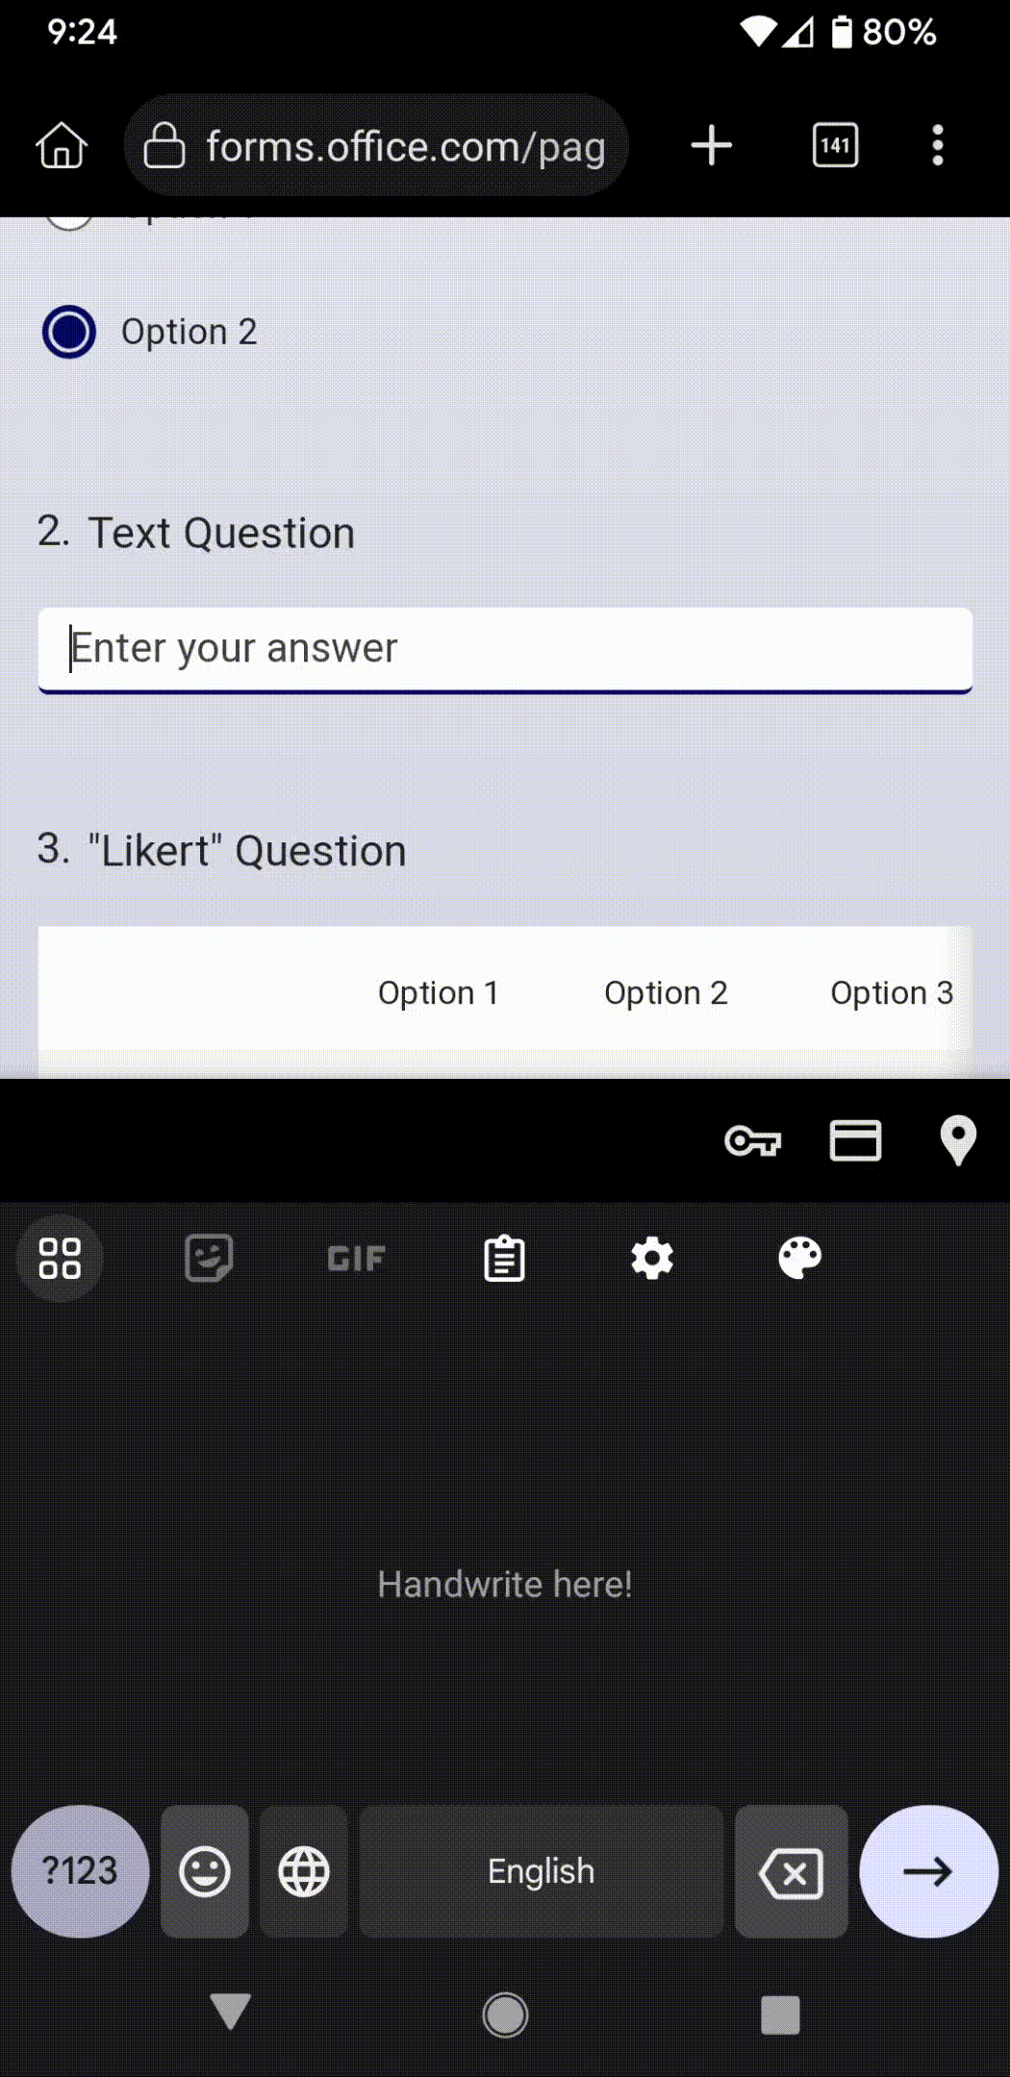
Microsoft Forms [2]
A form can be distributed through link, email, QR code, or embedded in a webpage.
When the form is viewed on a phone, the user can use the phone’s handwriting and voice typing features to input text.

Slide 12
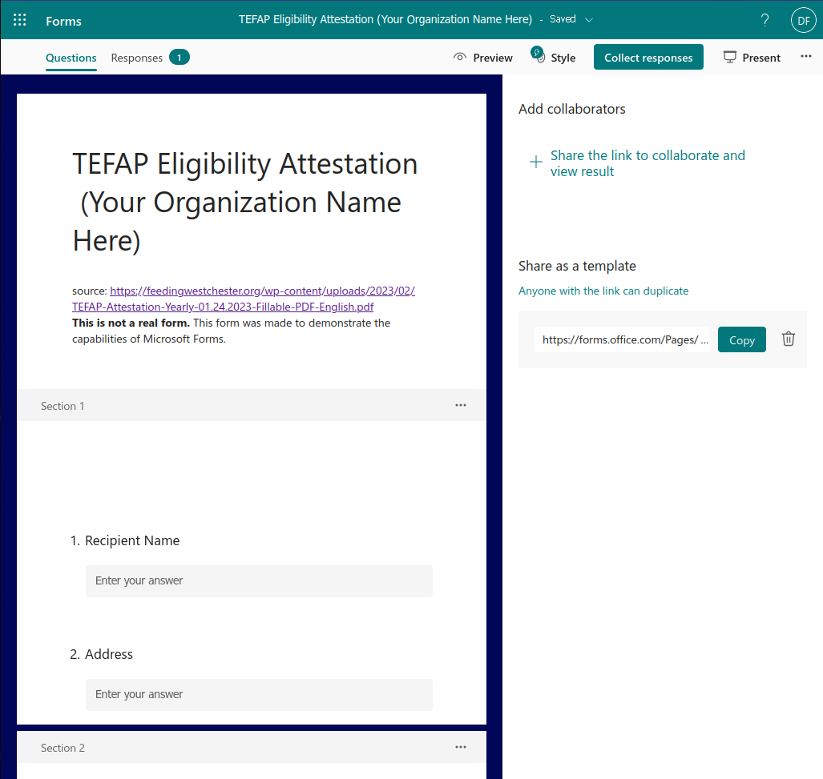
Microsoft Forms Templates
The U.S. government seems to have a generic PDF that any food distribution organization can print out and use as a TEFAP Eligibility Attestation form.
MS Forms has a similar feature. The creator of a form can share the form as a template via link; anyone who clicks on the link can duplicate the form, edit it, and use it for their organization.

Slide 13
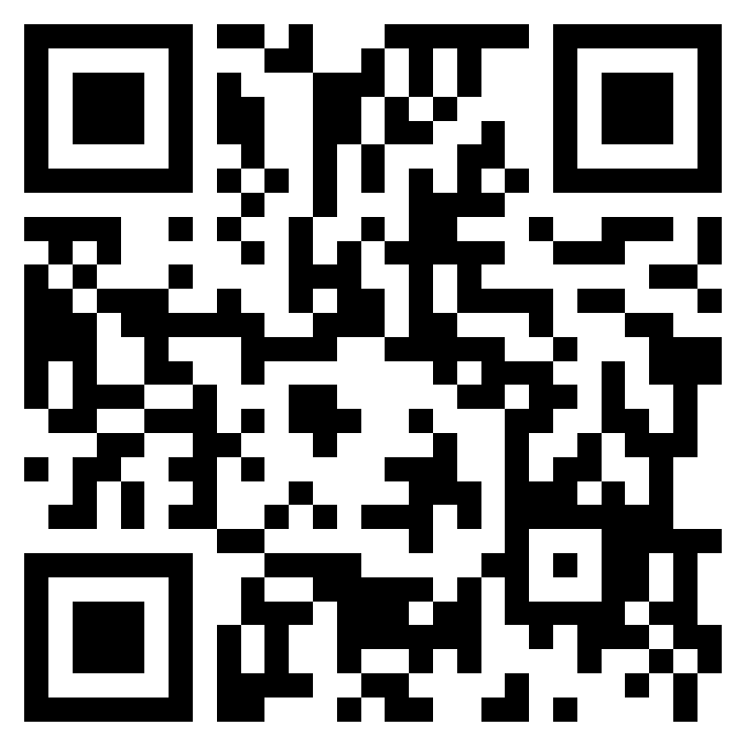
MS Forms Example:
TEFAP Attestation of Eligibility
To test for myself if MS Forms would be adequate for converting physical forms to digital, I decided to take a pdf of a TEFAP Attestation of Eligibility form and recreate it in MS Forms.

Slide 14
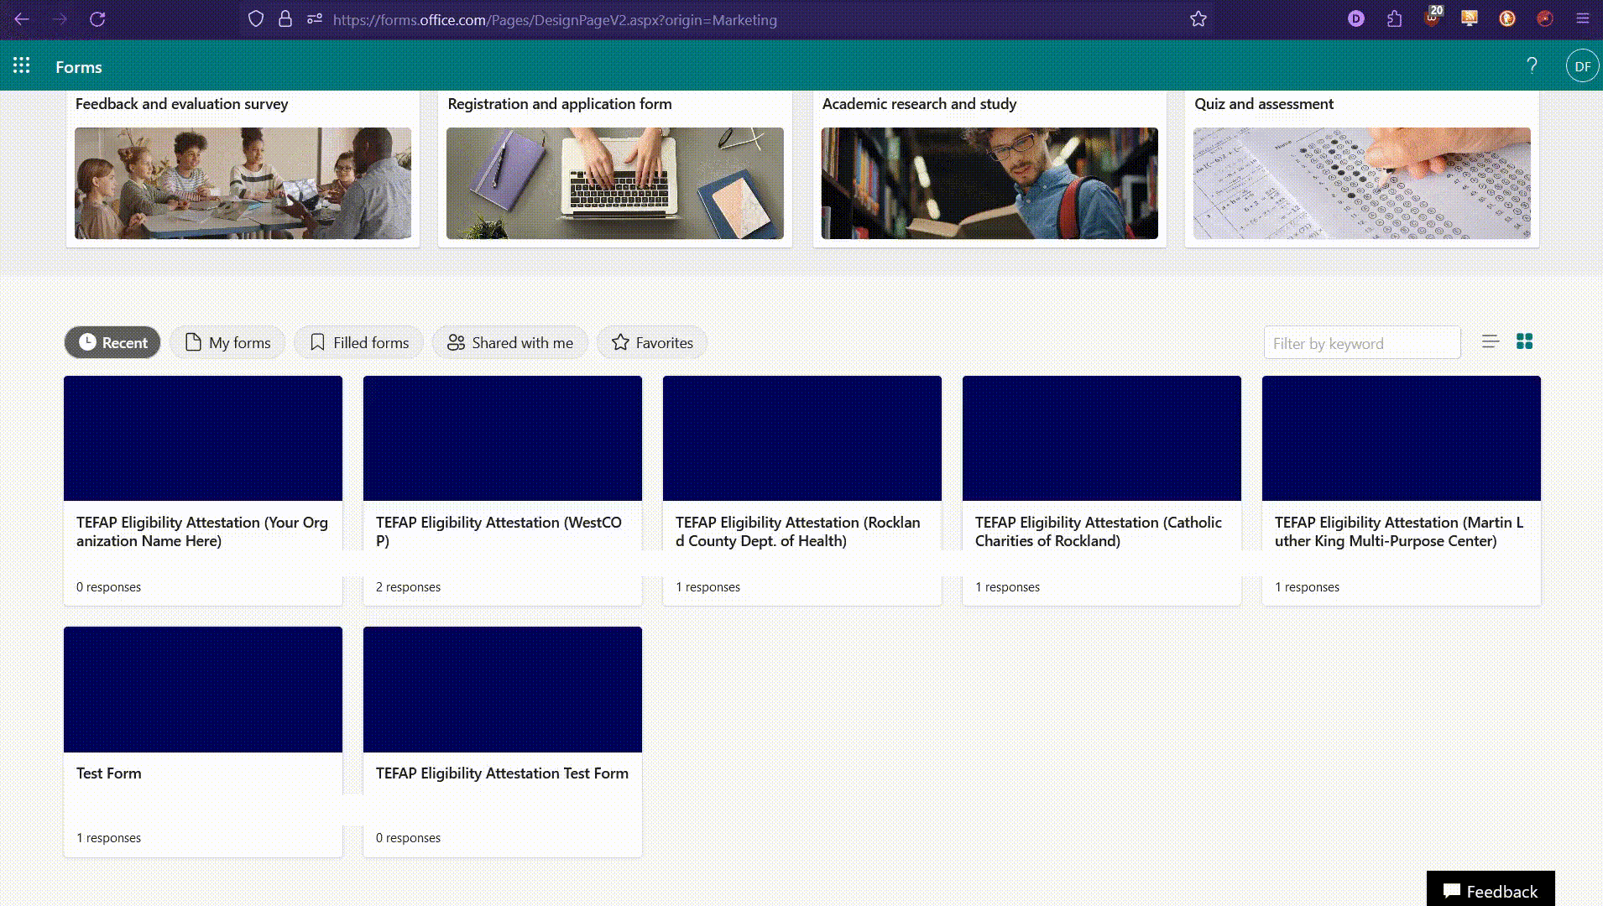
How to Consolidate Form Responses into an Access Database
First: Download all of the form response Excel files.
Sign in to the MS Forms website
Click on a form
Click the “Responses” tab
Click the downward arrow next to the Excel button
Click “Download a Copy” (you must have a local file to import data into Access)

Slide 15
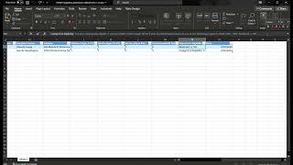
How to Consolidate Form Responses into an Access Database (2)
Clean up the Excel spreadsheets.
Remove all line breaks by typing Ctrl + J in the Find box. This will break Find until you restart Excel
Delete unnecessary columns
Shorten long text
Convert numbers as text to numbers by clicking the yellow warning icon

Slide 16
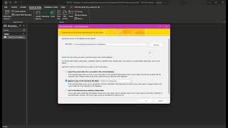
How to Consolidate Form Responses into an Access Database (3)
Import the Excel spreadsheets into Access
With a database open, click “New Data Source > From File > Excel”
Click “Browse” and open your cleaned Excel file
Leave all options at their defaults. Name your table
To append another spreadsheet later:
Repeat steps 1 & 2, but click “Append…to the table”. As long as the spreadsheet you’re appending was cleaned in the same way, it should append successfully.

Slide 17
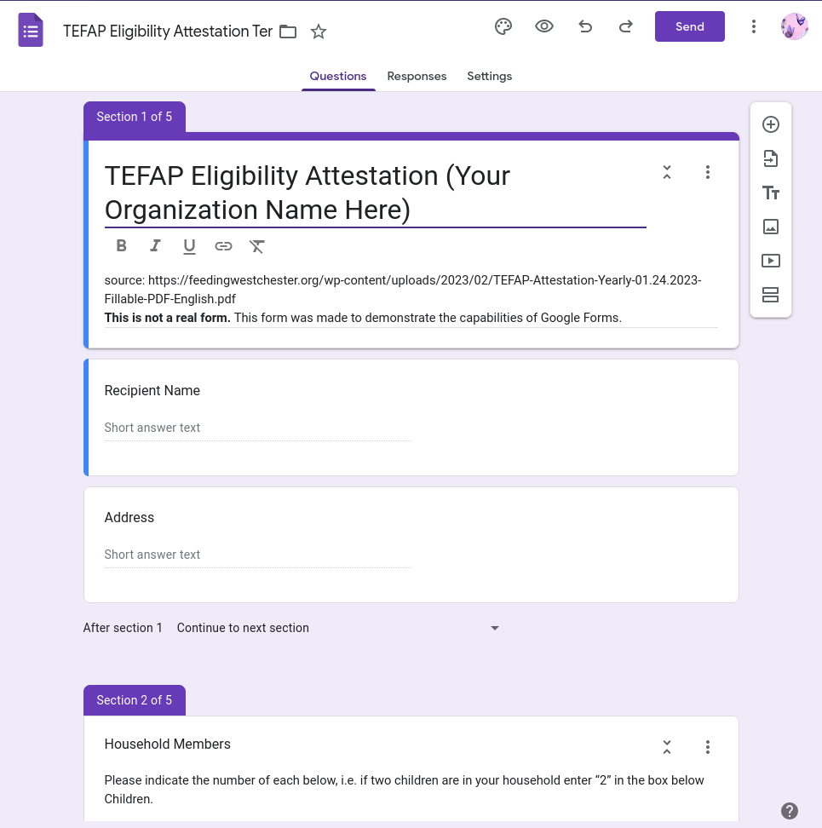
Alternative Idea: Google Forms and Google Sheets
If you wish to avoid the MS Office suite, it is possible to achieve the same interoperability with Google Forms, Google Sheets (alternative to Excel), and any database application that can import csv files (one example is LibreOffice Base).
Like MS Forms, one can open responses in a spreadsheet from the “Responses” tab of any Google Form.
Responses can be converted to csv from either G. Forms or G. Sheets.
The biggest con is that G. Forms cannot be shared as a template.
G. Forms TEFAP Eligibility Attestation Example

Slide 18
Existing Digital Record-Keeping Services for Food Distribution Orgs.
In order to compete with pencil and paper, digital record-keeping systems must be free.
I mentioned bosWell in a previous presentation. They’re free for food pantries to use. Their biggest flaw is that only social services orgs can learn how bosWell works. Their website is sparse, and the only ways to learn more are to schedule a demo, or to watch a video that inexplicably requires one to fill out a form with one’s name and organization to view it.
I have learned more about Feeding Westchester’s digital record-keeping services. It is called “Service Insights on MealConnect*” (2). Though the system was built by Feeding America, it is not mentioned on their website aside from training courses exclusive to FA’s partners. Many of FA’s partners have their own pages explaining the service and its benefits (1, 2, 3).
*MealConnect is FA’s app to connect FD orgs, volunteers and donors. It seems to share some goals in common with Jack Smith’s app, though the website only mentions food donation.

Slide 19
Thank you!

